Slide 1
Launching
R-Ladies Charlottesville
library(dplyr)
rladies_global %>%
filter(city == 'Charlottesville')
Fill out the survey if you haven’t already: https://goo.gl/oa1mJU
Follow us on Twitter: @RLadiesCville
November 14, 2017

Slide 2

Welcome!
You’re in the right place.
Whether you’re a R novice or R expert, this group is for you!
Notes:
Ask about experience
Fix hand

Slide 3
Agenda for today:
Introductions
What is R-Ladies?
Why R?
How to install and run R and R-Studio on your computer

Slide 4

1.
What is R-Ladies?

Slide 5

Worldwide organization
...that promotes gender diversity in the R community
...via meetups and mentorship
...in a friendly and safe environment
Notes:
How did I find out about it?
What is it doing now?
Who is interested in it? CelebRities

Slide 6
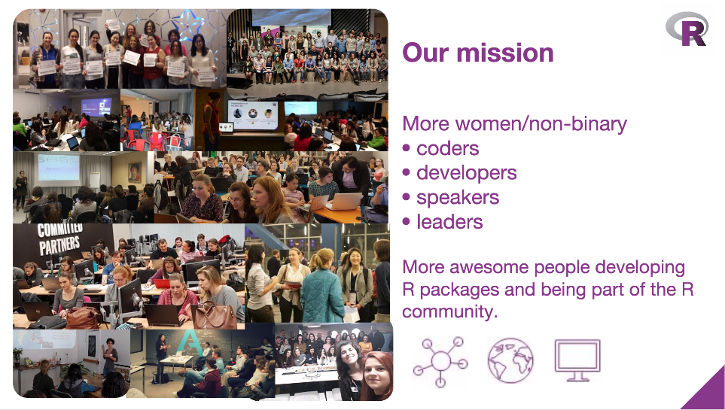
From R-Ladies Global, useR 2017 presentation

Slide 7
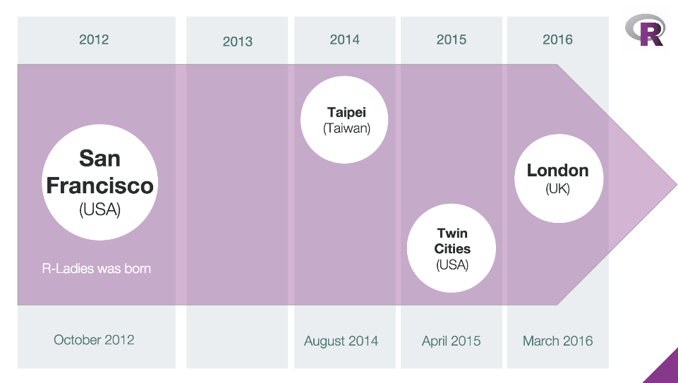
2017: C-Ville
From R-Ladies Global, useR 2017 presentation

Slide 8

2.
Why R-Ladies Charlottesville?

Slide 9
R-Ladies Charlottesville
Goals
Teach and learn R
Expand professional network
Meet amazing women
Get involved in the wider R community
Get involved in local tech community
Plans for the future
Monthly Meetups:
Presentations, workshops
Networking and events
RLadiesCville website
More 🍕🍕🍕

Slide 10




Sponsors + Friends (for now)
Look at all of this empty space!

Slide 11
It’s your group

Slide 12
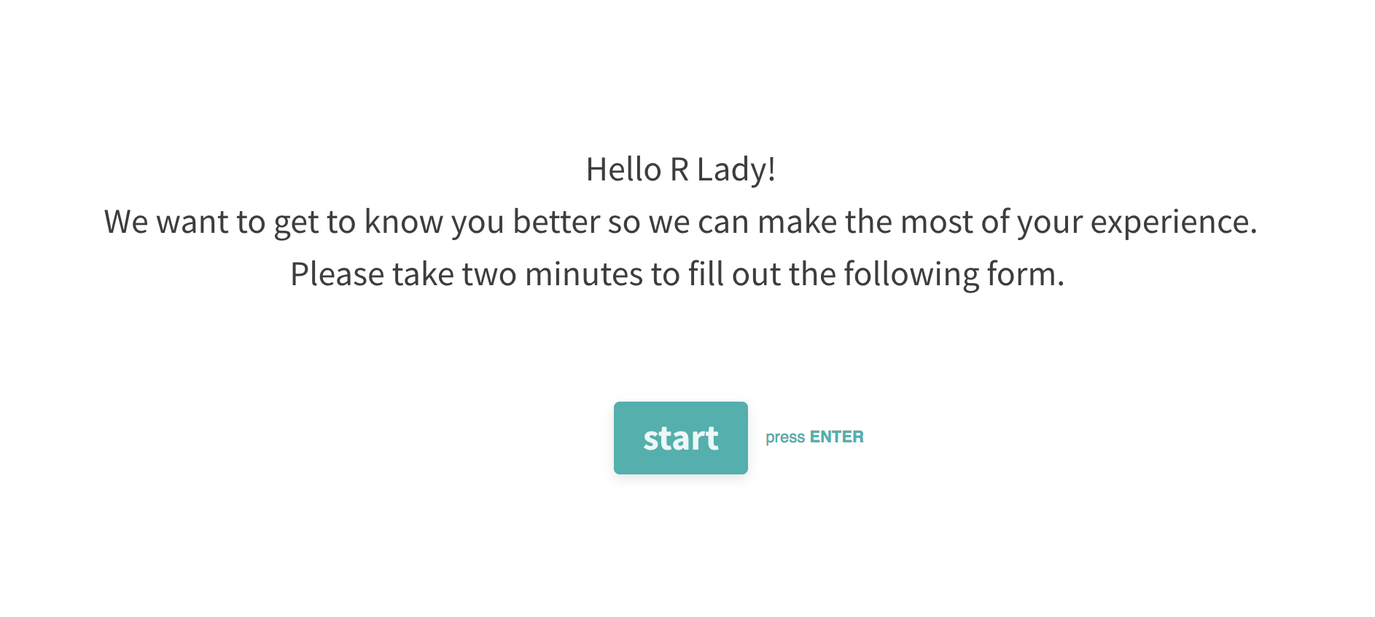
https://goo.gl/oa1mJU

Slide 13

3.
What can you do?

Slide 14
Tell your friends

Slide 15
Get involved
Learn
Join our Meetup page and attend events
Follow us on Twitter @RLadiesCville
Contribute
Join our GitHub page
Slack channel?
Ask questions
Organize
Lead a workshop
Give a talk
Ask your company to sponsor us
Be a co-organizer!

Slide 16
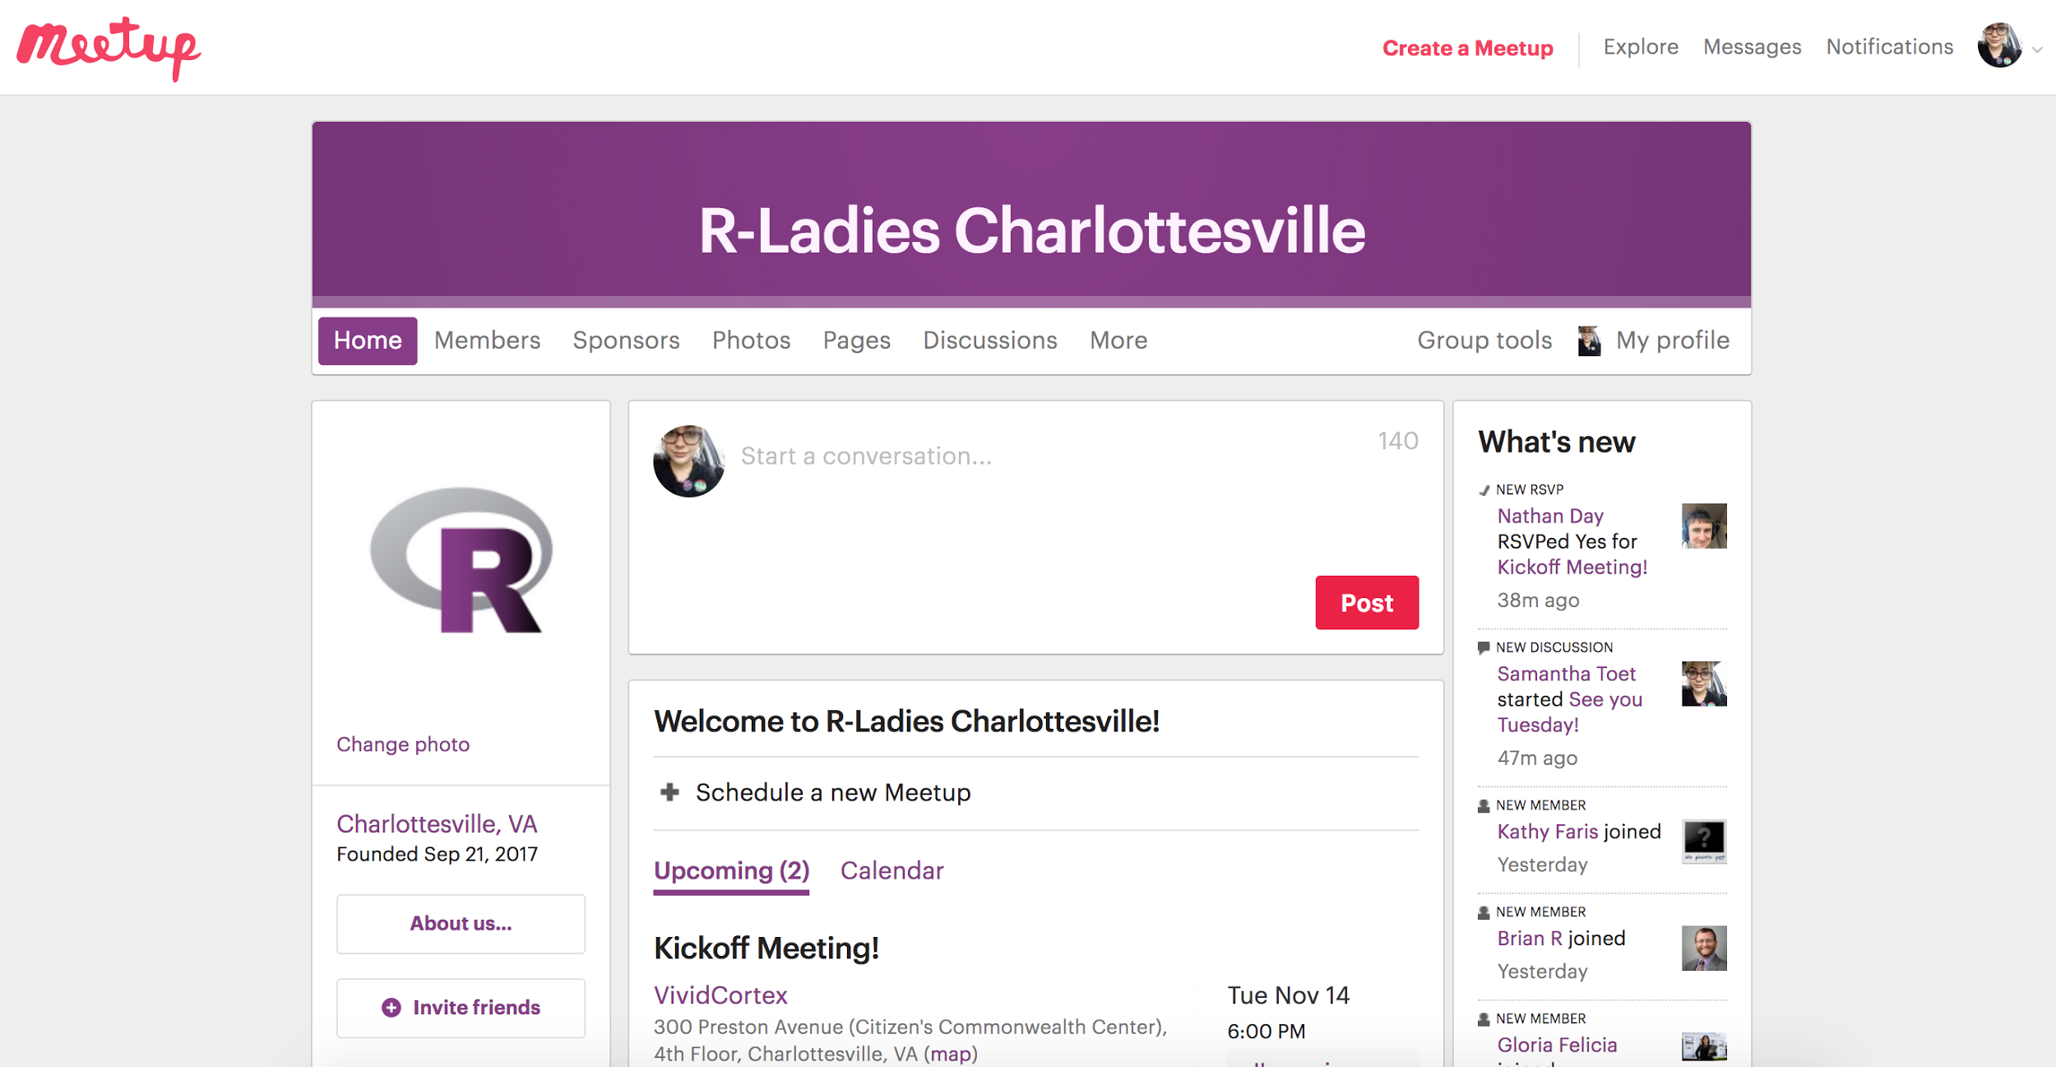
Find us online!
Website: https://rladies.org
Want to help create an R-Ladies Charlottesville site?
Twitter: @RLadiesCville
Meetup: https://www.meetup.com/rladies-charlottesville/
Github: https://github.com/rladies-charlottesville
Slides to be posted here
Check out the R crossword puzzle from RLadiesDC!
Email: charlottesville@rladies.org/ samantha@rladies.org

